Slide 1

Final project
Hailey Robinson

Slide 2
Business problem and Context
Movie producers need to know the key elements of creating a successful movie
Determine the factors that affect imdb scores
Help companies produce extremely successful movies that will get high imdb scores
Create a model that will be able to predict the success of a movie given important factors
Notes:
We were given a large dataset with information on movies from the imdb website, and different variables about those movies that could help us determine the success of the movie.
The business problem is that movie producers need to know the elements that go into a successful movies, so our first goal is to determine the important factors that affect the imdb scores.
We also want to be able to give advice to producers and investors on how to create a successful movie based on our analysis of this data
Our final goal is to be able to give advice to producers, investors on the important characteristics behind a successful movie.

Slide 3
Data transformation
Carryforward from midterm project
Drop unnecessary columns
Create dummy variables for content rating
Drop all missing variables
Notes:
Add columns I dropped:
director_name', 'movie_title', 'movie_imdb_link','plot_keywords', 'aspect_ratio’

Slide 4
regression
Type | MSE | Variance or R²
Multiple Linear Regression | 0.6570 | 0.4127
Ridge | 0.6570 | 0.4127
Feature Selection | 0.7056 | 0.3693
Lasso Method | 0.6708 | 0.4004
RandomForestRegressor | 0.0978 | 0.9127
Notes:
- According to our class notes, Regression is about finding a liner or nonliner function, which fits well with the dataset
- A multiple linear regression is testing how x variables are related to a y value. The coefficients are found by minimizing the error of prediction.
Our goal is to have a low Mean Square Error, and a high r squared, or variance.
- For our model, imdb_score was the y variable, and the x variable was all features except for imdb_score
- Random Forest Regressor was my best model. However, we didn't do any validation. It is creating a regression model based on our full dataset, and then comparing it against our data set, so of course it would be fairly accurate.

Slide 5
Classification
Type | Accuracy
Decision Tree | 0.717489
Knn (n_neighbors = 9) | 0.611659
Knn (n_neighbors = 5) | 0.620627
Logistic Regression | 0.681614
Random Forest | 0.763228
Notes:
With classification, our goal is to build a model that can predict if a movie is good or bad. According to our notes… Classification is about finding a liner or nonliner function, which separates different classes in y value
Start by creating a new categorical column called imdb score category where we place the imdb scores into bins. Less than 4 being bad, 4- 6 being OK, 6-8 being good and 8-10 representing excellent. Then drop the column imdb_score so you don’t have that variable twice in the data
Decision Tree:
Most intuitive
Implicitly perform feature selection (selecting which X variables are important)
Requires little effort from users for data preparation (can handle missing values)
Easy to interpret and explain to executives!
Provides decision rules
Logistic Regression:
To deal with multicollinearity, remove one dummy variable. I removed content_rating_0.0
Used Extra Tree Classifier to look at variable importance
Random Forest is a great model. It gave me my highest accuracy and therefore would be able to predict if a movie was good or bad.

Slide 6
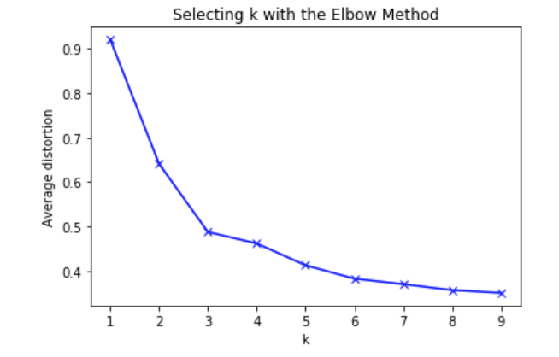
Clustering
Normalize the data
K-means
Optimal K Value using the elbow method,
Based on mine, number of clusters = 3
Agglomerative Clustering (Hierarchial)
Notes:
Normalize the data! Take the amount, subtract the mean and divide that by the difference between the maximum and minimum amount for that variable, basically we are adjusting the values to a common scale
it groups points that are “close” to each other, it identifies structure or patterns in the data, and is unsupervised learning, so there are no predefined classifications.
There are:
1741 in cluster 0
1292 in cluster 1
682 in cluster 2
Based on the analysis of each cluster:
Cluster 0: has the lowest number of voted users, the shortest duration, the lowest number of critical reviews, and the lowest budget. I would assume this is the "bad" movies in this cluster.
Cluster 1: has the highest number of voted users, the longest duration, the highest number of ciritcal reviews and the highest budget. However, it has a slightly lower score for imdb_score_category, so these might be the "average" movies.
Cluster 2: has the median number for all variables, except for imdb_score_category. This could mean that these are the great movies and ones with the highest success rate.
Feature Importance:
1) number of voted users
2) duration
3) gross
4) budget
5) number of critical reviews
Agglomerative Clustering (Hierarchical)
There are:
- 724 in cluster 0
- 123 in cluster 1
- 2302 in cluster 2
- Cluster 0 has the median number of voted users, the median duration, the median number of critical reviews, and the highest budget
- Cluster 1 has the highest number of voted users, longest duration, highest number of critical reviews and the lowest budget
- Cluster 2 has the lowest number of voted users, the lowest duration, the lowest number of critical reviews and the median budget
I would assume that Cluster 0 are the Okay movies, cluster 1 is the excellent movies, and cluster 2 is the bad movies.
Compare the results from profiles by looking at their means. These two clustering models are surprisingly different in the number of movies in each cluster and the means in each cluster. However, they both show very little difference in means for variables that are not important, and a large difference in means for highly important variables.

Slide 7
Storytelling - Most important variables
Number of user reviews
Duration
Number of critical reviews
Budget
Profit

Slide 8
Storytelling - Recommendations
Use social media to ask fans to review the movie
Produce a longer movie
Dealing with critical reviews
Large budget
Promotion
Additional Variables to improve analysis → Marketing data
Notes:
My recommendations are very similar to when we completed the midterm project. Based on the variables on the previous slide, I have a few recommendations
Ask fans on Social Media (director, movie, and cast) to review the movie on imdb. Assuming that fans are the ones who follow the director and cast on social media, hopefully these would be good reviews. Based on our analysis, the more reviews you have, the more successful the movie is. If the movie has a high score on imdb, more people are likely to watch the movie. And to the viewers - review the movie if you really love it!
Produce a longer movie. It seems odd to me, but movies with a longer duration seem to have better success. If the movie is great, fans want to see more of it!
Critical reviews come along with asking people to review your movie. There are going to be some critical reviews for every movie, and if you have a large number of reviews, you are also going to have a large number of critical reviews. One of our variables is the percentage of critical reviews. This isn't an important variable which means that you don't need a large number of critical reviews to be successful, you just need reviews in general.
Try your best to get a large budget. This analysis is something that you could show to investors, proving that if there is a larger budget, the movie is more popular and therefore has a higher profit and return on investment for them. A larger budget helps get better producers, more popular actors/actresses which draws in more viewers.
Promotion. Be sure you are promoting the movie to the right crowds, or produce a movie that would be popular for all ages. The more viewers you have, the more reviews you could get, and the larger your profit will be!
Additional Variables to improve analysis: I think it would be interesting to have data on how much was spent on the marketing for the movie. There could be a large correlation between the amount of marketing that was spent on the movie and the success. From market research before the movie is produced to promotion for the movie, there could be an interesting relationship between these variables.
Final Note: There are many different ways that this analysis could be done, and this is just one way of looking at it. There are many more graphs and analysis that could be done if you wanted to take a deeper look at specific aspects of the data and relationships between certain characteristics.

